Slide 1
COLLAGE COMPANION
TEAM MEMBERS: .
Name Roll number
Sumalatha 2403A51003
Rishitha 2403A51005
Shreya 2403A51020

Slide 2
OBJECTIVES:
To create a simple and user-friendly web application for college students to
manage their daily academic activities.
To allow users to record ad view class schedules, assignments, exams,
and personal notes in one place.
To provide a built-in GPA calculator for tracking academic performance.
To ensure data persistence using browser-based storage (LocalStorage) without
requiring a database or backend.
To improve students’ time management and productivity by integrating
academic information in one accessible platform.

Slide 3
STAKEHOLDERS:
Students (End Users): They are the main users of the application who use it to manage their academic
activities like schedules, assignments, exams, and notes.
Developers / Project Team: They are responsible for designing, coding, testing, and maintaining the web
application to ensure it works efficiently.
Faculty Members (Indirect): They may recommend or support the use of the app to help students stay organized
and manage their studies effectively.
Educational Institutions: They can adopt the system as a productivity tool to enhance student engagement
and academic planning.
Project Supervisor / Evaluator: They evaluate the project’s functionality, design, innovation, and overall
implementation quality for academic assessment.

Slide 4
PROGRAMMING LANGUAGES, TOOLS,AND SOFTWARE :
Programming Languages :
HTML5.
CSS3.
JavaScript.
Tools Used:
GitHub .
Canva / Figma .
Chatgpt.
Software Used:
Visual Studio Code (VS Code).
Web Browser (Google Chrome, Edge, Firefox).
LocalStorage (Browser API).

Slide 5
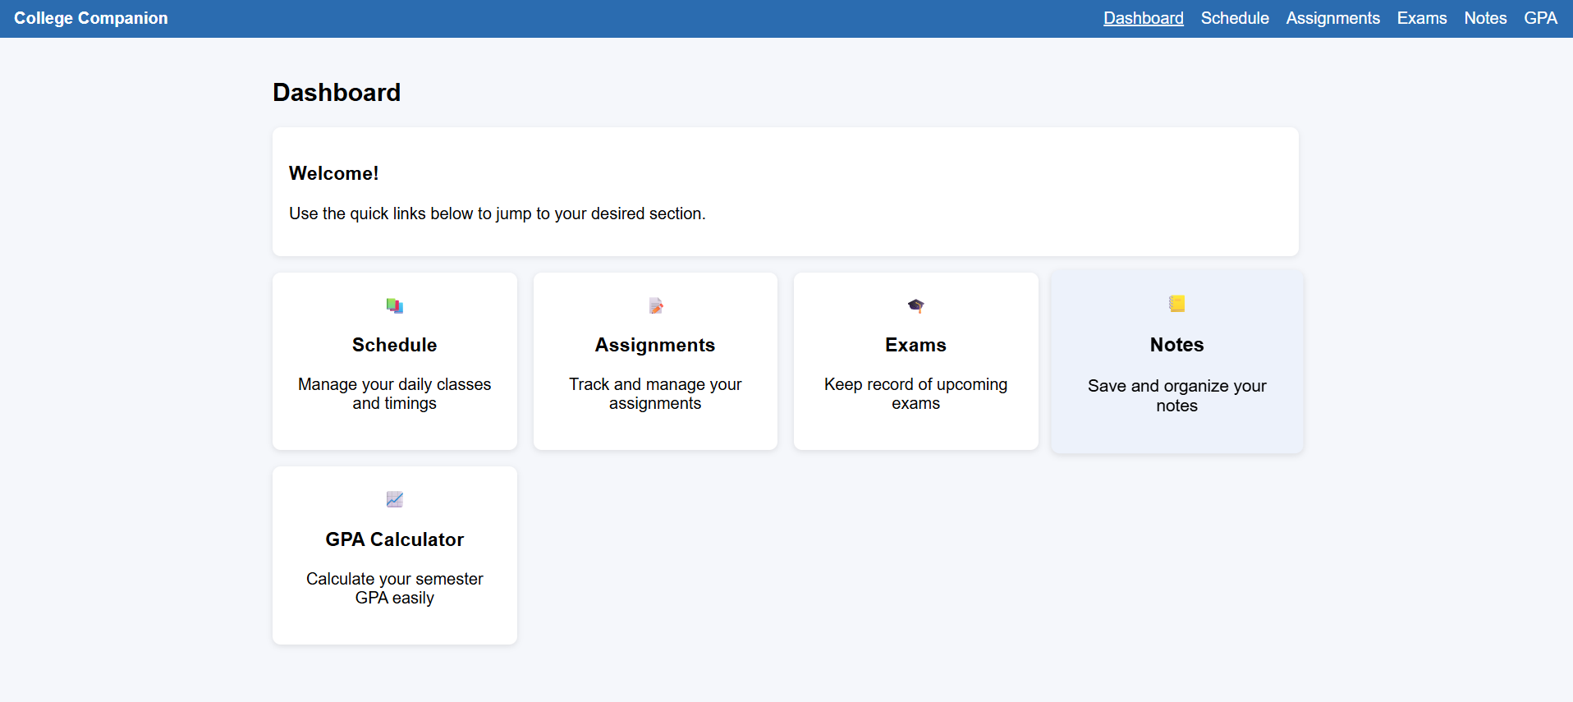
FRONT-END VIEW OF WEB/MOBILE APPLICATION:

Slide 6
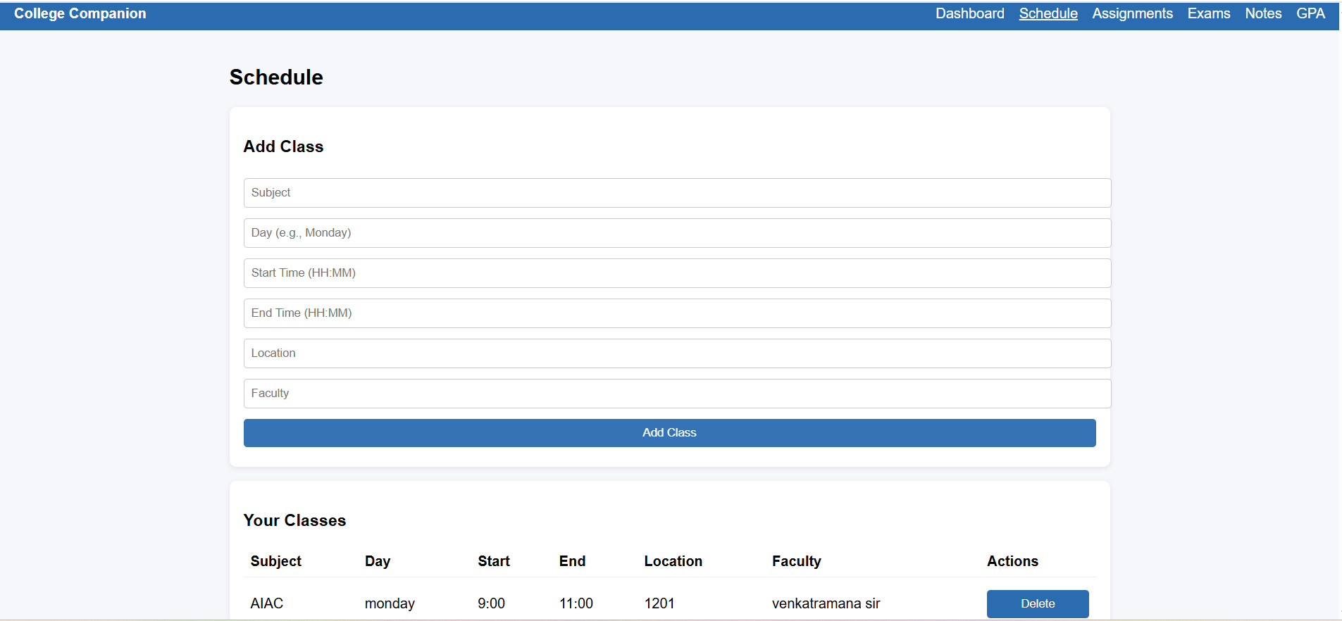
.

Slide 7
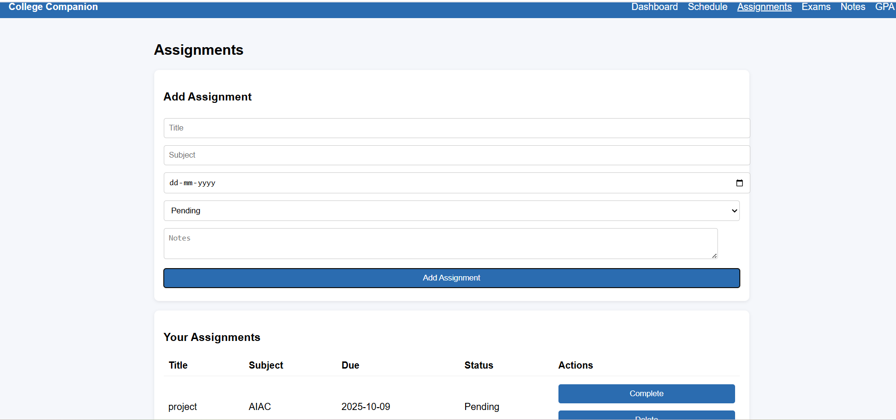
.

Slide 8
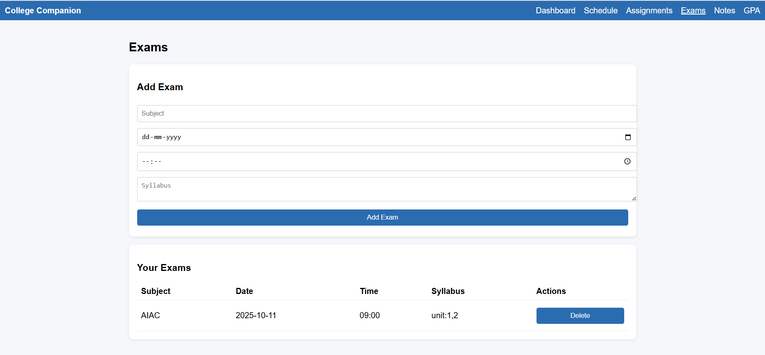
.

Slide 9
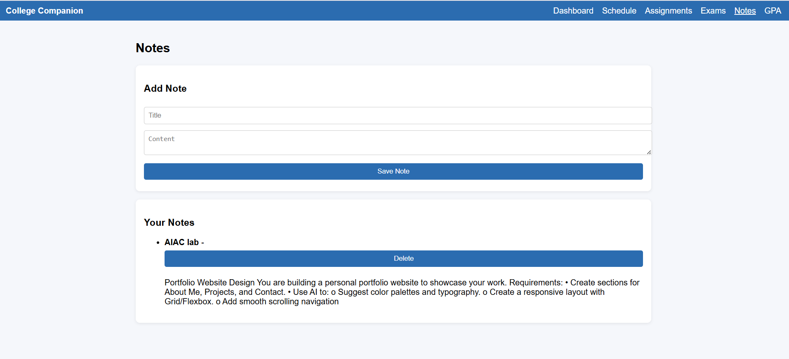
.

Slide 10
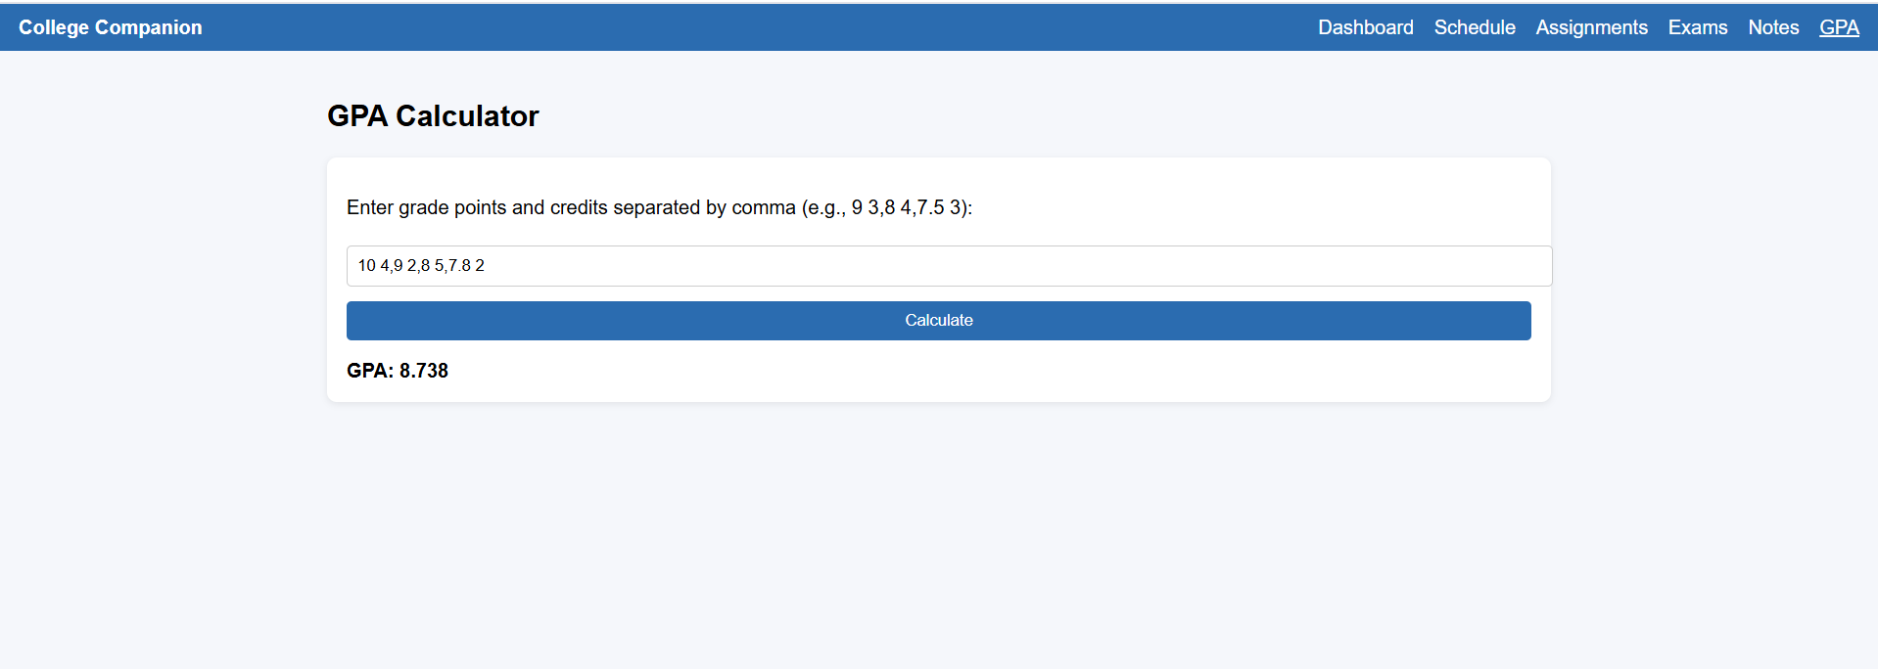
.

Slide 11
THANK YOU

